Slide 1

SER 502 – Team 16
Tarun Kolla – 1213401629
Naga Ravi Teja Thoram – 1212933421
Koushik Kotamraju – 1213181383
Pranav Mandadi - *
GitHub repo - https://github.com/tarunkolla/SER502-Spring2018-Team16
Youtube link:

Slide 2
FISH
FISH is a simple programming language designed using JAVA, inspired by Python and Standard ML
Parse tree and Intermediate byte code is generated using ANTLR
Runtime written in JAVA
Language Design:
Every program must lie between “startFISH” and “endFISH”
Input program should have .fish file extension
Intermediate code generated as <program_name.fish.ic>
This intermediate code is processed by runtime to generate program output

Slide 3
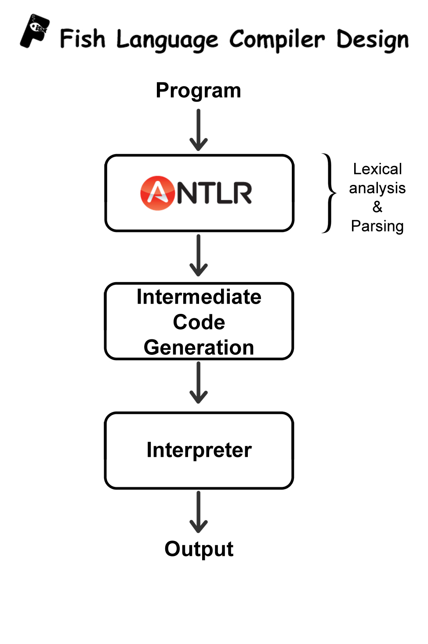
Language Design:

Slide 4
Tools:
Compiler:
Based on JAVA Environment
ANTLR4 used to generate Lexer and Parser
Run Time:
JAVA : Used to build the entire project JDK 1.8
Eclipse : Used as IDE

Slide 5
Features of FISH:
Datatypes:
Arithmetic Operations:
Relational Operations:
Integer Numbers
Real Numbers
BOOLEAN
Add +
Subtract -
Multiply *
Divide /
Mod %
Equals ==
NotEqualTo !=
LessThan <
LessThanEqualTo <=
GreaterThan >
GreaterThanEqualTo >=
Logical Operations:
AND &&
OR ||

Slide 6
Statements
General Statements
Conditional Statement
Iterative Statement
Assignment Statement “=”
Declaration Statement “$”
Read “read f”
Write “write “result = ””
If (condition):
<statements>
<optional else>:
<statements>
endif
loop (condition):
<statements>
endloop

Slide 7
Execution Flow:
Compiler
Runtime Interpreter
Source code program.fish
Intermediate Code
Output

Slide 8
Byte Code Instructions:
PUSH
ASSIGN
PARAMASSIGN
DECLARE
DISPLAY
READ
WRITE
ADD/SUBTRACT/MULTIPLY/DIVIDE/MOD
AND/OR
BASIC INSTRUCTIONS
ARITHMETIC OPERATIONS
LOGICAL OPERATIONS
DECLARE
PUSH
ASSIGN
PARAMASSIGN
DISPLAY
READ
WRITE
ADD
SUBTRACT
MULTIPLY
DIVIDE
MOD
AND
OR
RELATIONAL OPERATIONS
GREATERTHAN
LESSTHAN
GREATERTHANEQUAL
LESSTHANEQUAL
NOTEQUAL
EQUALS
CONTROL OPERATIONS
GOTO
FAILGOTO
RETURNTO
ENDIFGOTO

Slide 9
Sample Program:
Input Code
Intermediate Byte Code
startFISH
$a
$b
$c
a=3
b=5
if (a % 2 == 0):
c=10
else:
c=a+b
endif
write c
endFISH
1 START FISHING
2 DECLARE a
3 DECLARE b
4 DECLARE c
5 PUSH a
6 PUSH 3
7 ASSIGN
8 PUSH b
9 PUSH 5
10 ASSIGN
11 STARTIF
12 PUSH a
13 PUSH 2
14 MOD
15 PUSH 0
16 EQUALS
17 FAILGOTO 22
18 PUSH c
19 PUSH 10
20 ASSIGN
21 ENDIFGOTO 29
22 STARTELSE
23 PUSH c
24 PUSH a
25 PUSH b
26 ADD
27 ASSIGN
28 ENDELSE
29 PUSH c
30 DISPLAY
31 END FISHING

Slide 10
RUNTIME

